Slide 1
Estimating Trends with Differences
Observing the Mean of 1st differences
T-Tests

Slide 2

Trends
Trend is an increase or decrease in a series that persists for an extended time (generally 7 or more- R of T)
Difficult to detect if randomness and seasonality is present
See the process of using differences to estimate trends – simple, but effective.
First differences

Slide 3
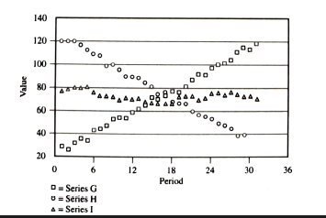
Trends
3 series:
With trends: G & H
No trend: I

Slide 4
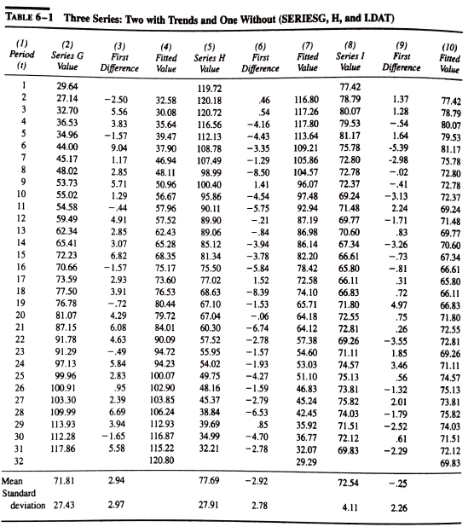

Slide 5
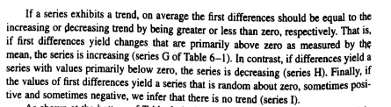

Indication: Presence/ Absence of Trends

Slide 6
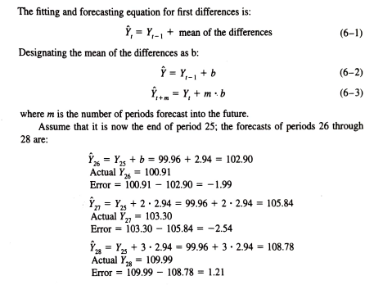
Forecasting with Differences

Slide 7
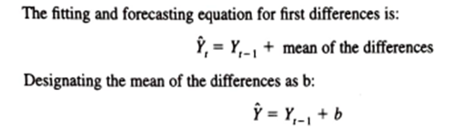
A mean ( term b in the equation) nearly equals zero is an indication of no trend Ascertain using (a) A frequency Distribution and (b) T-test

Slide 8
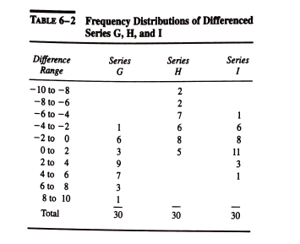
Trends: Analyzing Frequency distribution to infer regarding mean (mean nearly equals zero an indication of no trend
+ve and –ve of Series I nearly add up to zero => no trend versus G and H
A mean nearly equals zero is an indication of no trend

Slide 9
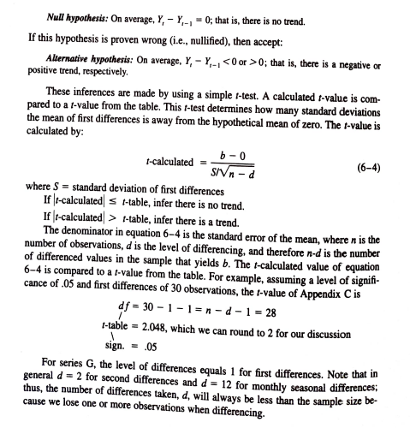

T Test to confirm status of mean
A mean
(b is average mean) nearly equals zero is an indication of no trend

Slide 10
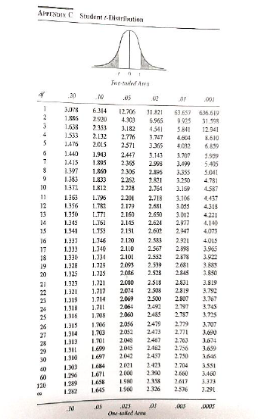

Slide 11
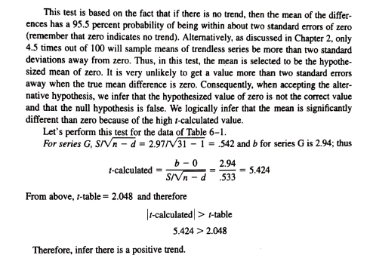
T-Test

Slide 12
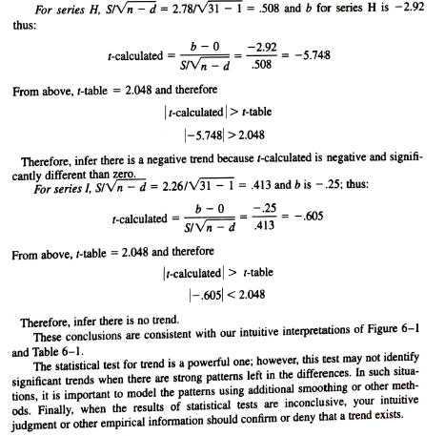

Slide 13
Advantages/ Disadvantages using Differences
Advantages
Trend is easily calculated
Easily interpreted
Significance easily tested using Hypothesis Test
Disadvantages
Weakness in dealing with outliers-differences do not smooth out extreme outliers
Future forecasts will be affected adversely by outlier values
Hence double MA or exponential smoothing would be appropriate there
However, differencing is a very powerful method.

Slide 14
Thank You

